Slide 1
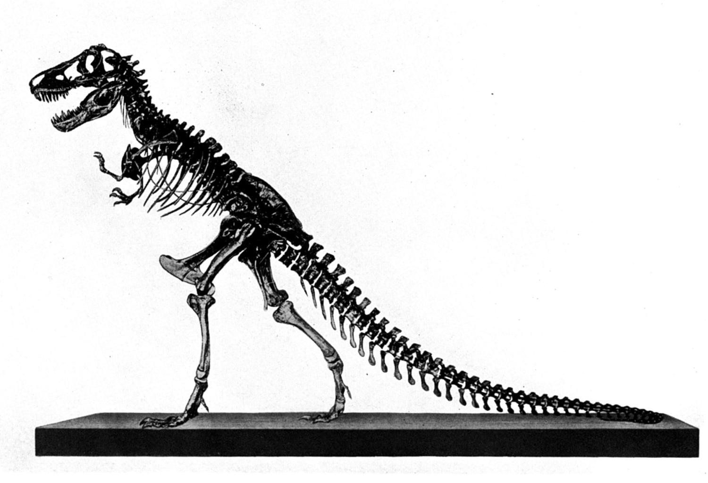
Behemoth &
Leviathan
Job 40:15-41:34
content
Part 3a

Slide 2
Review:
1 evidence for dinosaurs and man living together
2_{(a-d)} the conflict between Job, friends, Jehovah; Elihu’s response; God’s 1st response
3_{a} God’s 2nd response –the BEHEMOTH
concept
context
content

Slide 3
Previously:
Rebuked from a whirlwind for darkening counsel with words without knowledge (38:1-3)
Wanted answers but received questions
Silenced but no repentance (40:3-5)

Slide 4
God’s Second Reprimand (Job 40:6-41:34)
Job needed full repentance
Elihu warned Job (33:12, 13)
God’s second response capitalizes Elihu’s warning
  Which is why Behemoth and Leviathan must be literal creatures
    As the mountain goat, wild donkey, wild ox, ostrich, horse, hawk, eagle (Job 39)

Slide 5
Jehovah’s Second Response
(part a)
Job 40:6-24
BEHEMOTH

Slide 6

Behemoth & Leviathan
the arm of God (40:9)
the majesty of God (40:10)
the power of God to humiliate the proud (40:11, 12)

Slide 7
BEHEMOTH – The Colossal Beast (40:15-24)
“The word ‘Behemoth’ (Job 40:15) is literally a plural form of a common Old Testament (OT) word meaning ‘beast’. However, practically all commentators and translators have agreed that here we have an intensive or majestic plural, so that the meaning is something like ‘colossal beast.’”
(Steel, Allan K., “Could Behemoth Have Been A Dinosaur,” http://www.answersingenesis.org/articles/tj/v15/n2/behemoth)

Slide 8
“Made Along With You”
“Look now at the behemoth, which I made along with you; He eats grass like an ox” (Job 40:15)
positively rules out a figurative animal
positively affirms the Genesis record of creation (Gen. 1:24-31)
  man’s opinion says “millions of years before”
  God’s infallible word says “with you”
positively rules out an ox

Slide 9
THE TALE OF
TAILS
Some have suggested that Behemoth is a hippopotamus or elephant

Slide 10
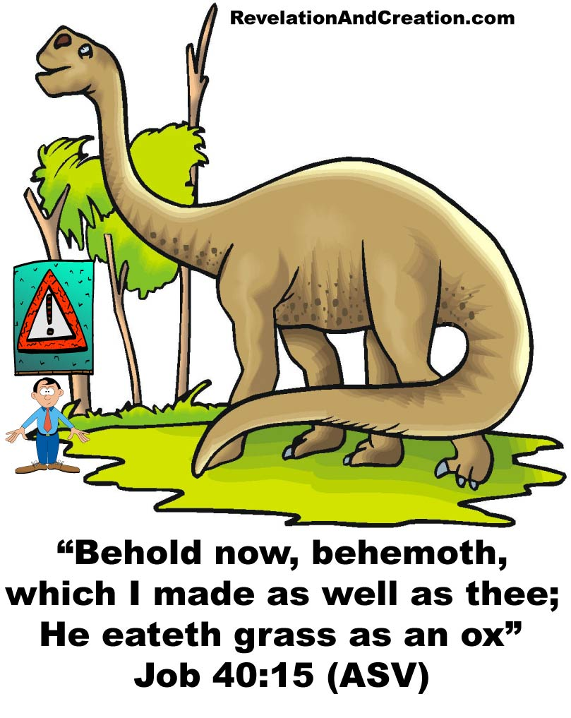
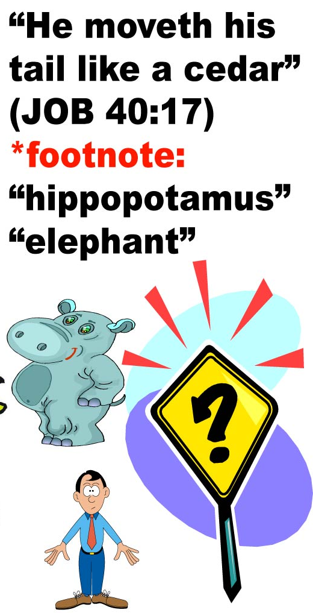
Like a cedar?

Slide 11
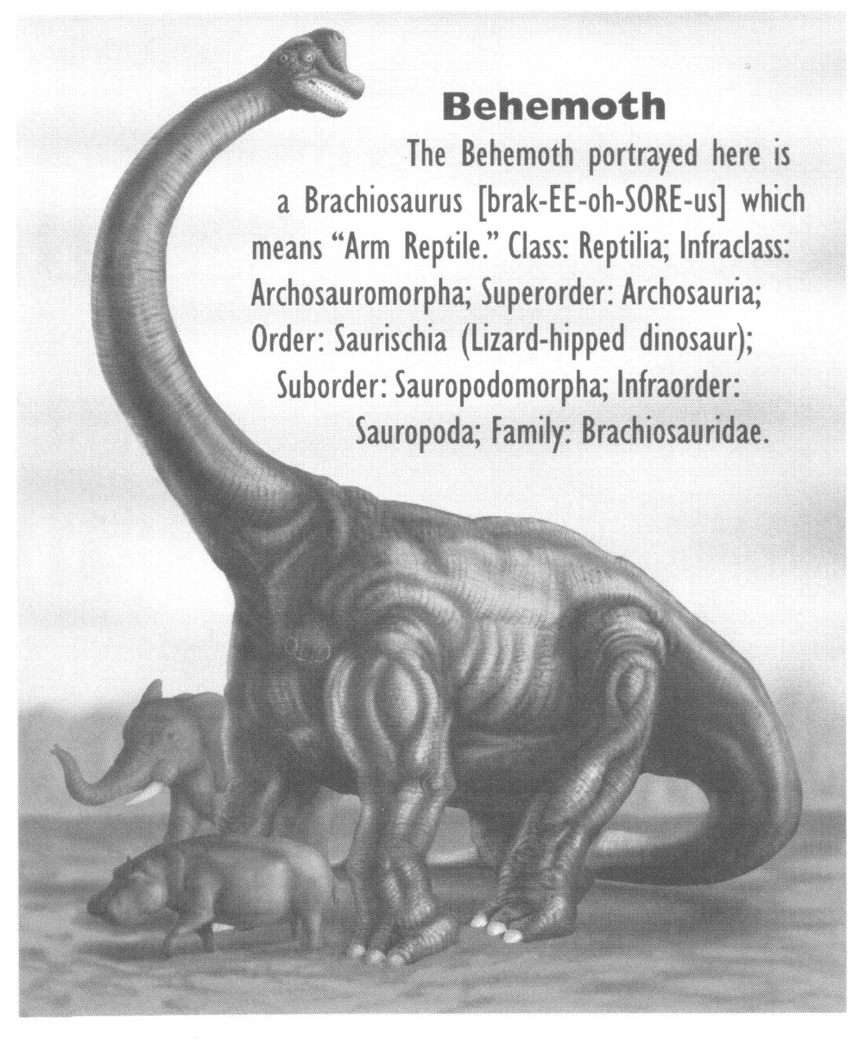
He is the first of the ways of God; Only He who made him can bring near His sword”
(Job 40:19)
The First Of The Ways Of God?
?

Slide 12
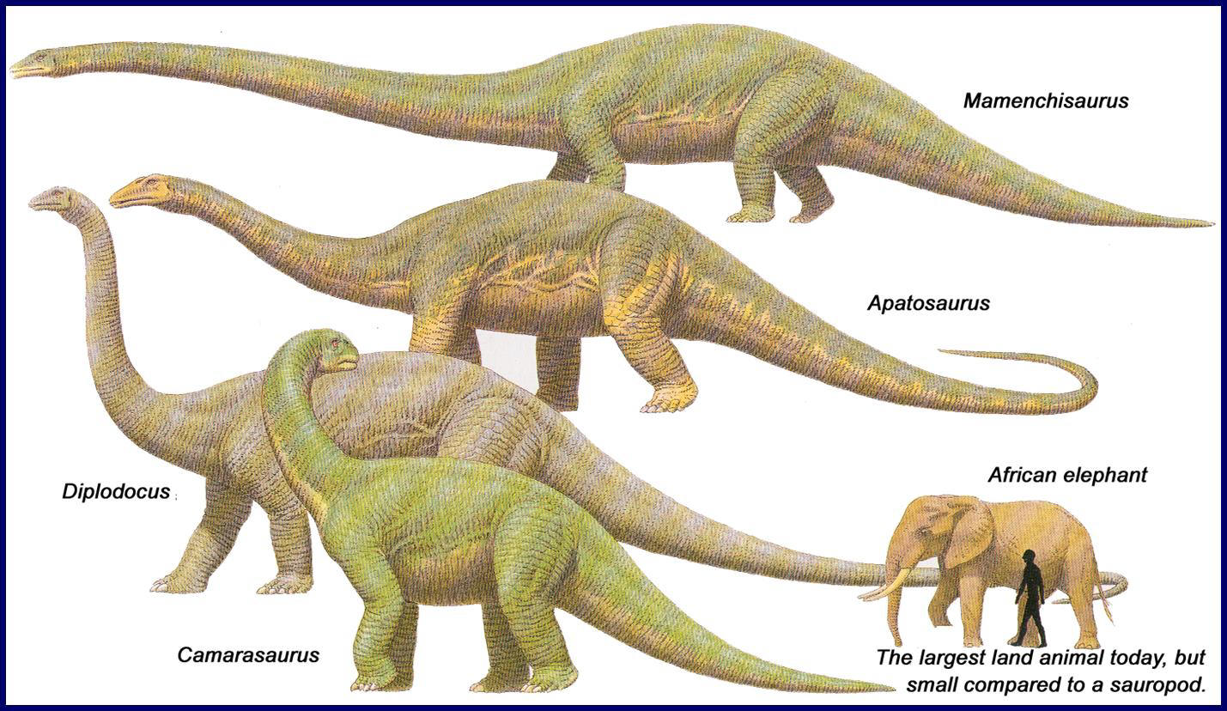
http://blackrainbow-blackrainbow.blogspot.com/2011/07/2-dinosaurs-of-jurassic-period.html

Slide 13
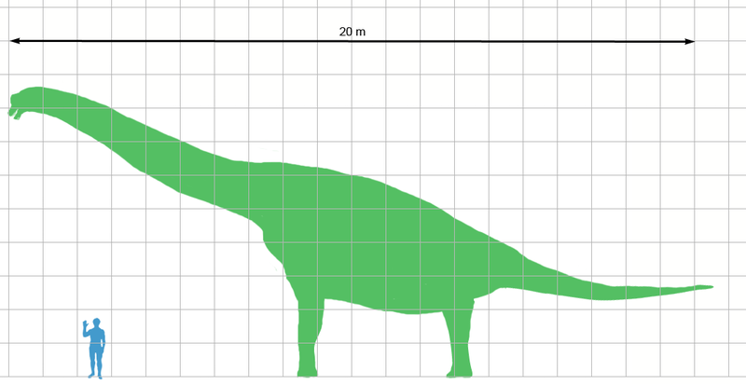
Size Comparison
“ Only He who made him can bring near His sword” (Job 40:19)
Wikimedia Commons.

Slide 14
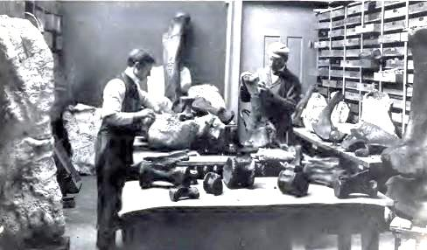
“Bones Are Like Beams Of Bronze”(Job 40:18)
Wikimedia Commons.

Slide 15
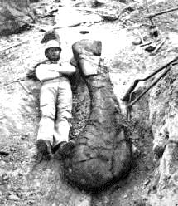
“Bones Are Like Beams Of Bronze”(Job 40:18)
Wikimedia Commons.

Slide 16
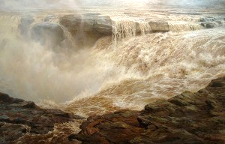
Mountains, Marshes, Rivers
20 Surely the mountains yield food for him, And all the beasts of the field play there.
21 He lies under the lotus trees, In a covert of reeds and marsh.
22 The lotus trees cover him with their shade; The willows by the brook surround him.
23 Indeed the river may rage, Yet he is not disturbed; He is confident, though the Jordan gushes into his mouth,
24 Though he takes it in his eyes, Or one pierces his nose with a snare.

Slide 17
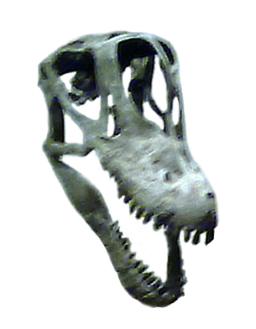
Mouth, Eyes, Nose
20 Surely the mountains yield food for him, And all the beasts of the field play there.
21 He lies under the lotus trees, In a covert of reeds and marsh.
22 The lotus trees cover him with their shade; The willows by the brook surround him.
23 Indeed the river may rage, Yet he is not disturbed; He is confident, though the Jordan gushes into his mouth,
24 Though he takes it in his eyes, Or one pierces his nose with a snare.

Slide 18
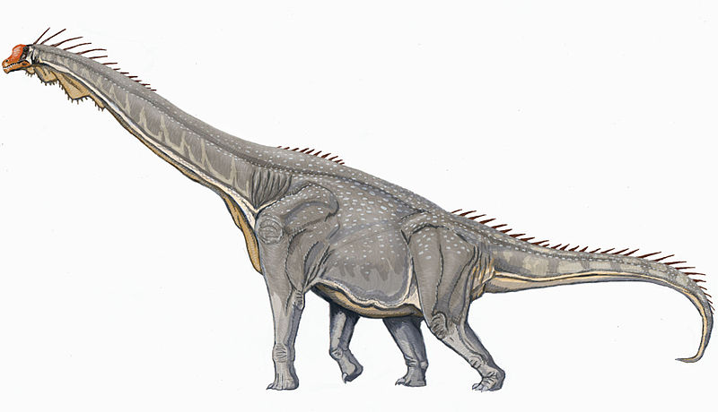
“Behold Behemoth”
Was a real creature
Does not match an elephant or Hippopotamus
Does match with the remains of large sauropods unearthed by man
Serves as an admonition:
  The superiority of heaven’s power
  The rebuke against man not trusting in God

Slide 19
“Behold Behemoth”
WHY OPPOSITION?
The only reason Behemoth is rejected as being a dinosaur is based on a prevailing “millions of years” hypothesis to origins
The Bible affirms that man and all land animals began on the same day
(Gen. 1:24ff; Ex. 20:11; Is. 40:21; Mk. 10:6; Rom. 1:20; Heb. 9:26)

Slide 20
Behemoth Immovability
Man often becomes restless and flighty in the face of adversity (Ps. 55:1-8)
The immovability of Behemoth is seen in Christ:
  “Therefore thus says the Lord GOD:
  ‘Behold, I lay in Zion a stone for a foundation, A tried stone, a precious cornerstone, a sure foundation;
  Whoever believes will not act hastily’”
  (Is. 28:16; cf. 1 Pet. 2:6-8)

Slide 21
Behemoth Immovability
The immovability of Behemoth is found in trusting in the promises of God
  1 The righteous perishes, And no man takes it to heart; Merciful men are taken away, While no one considers That the righteous is taken away from evil.
  2 He shall enter into peace; They shall rest in their beds, Each one walking in his uprightness.
  (Is. 57:1, 2)

